Slide 1


First order ordinary differential equations
REDUCEABLE TO SEPARABLE (HOMOGENEOUS EQUATION)
Bernoulli Differential Equation

Slide 2
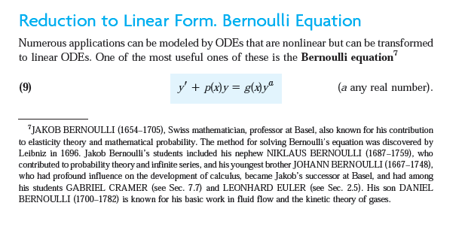
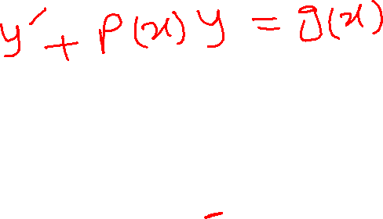

Slide 3

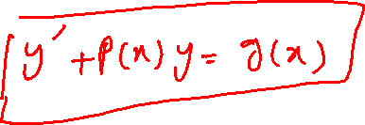


Slide 4




Slide 5



Slide 6
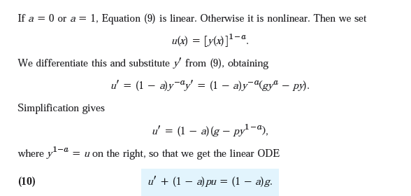

Slide 7
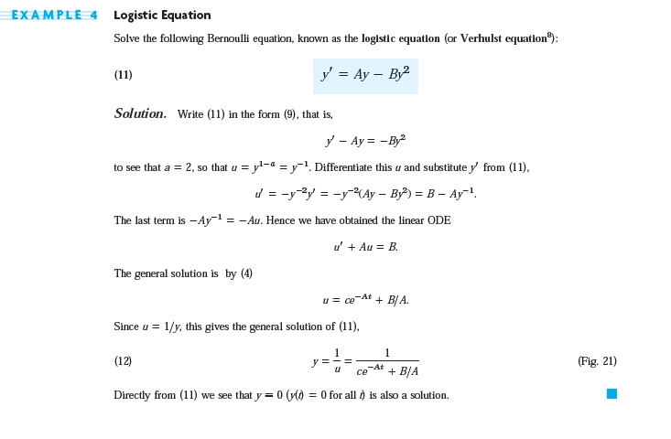

Slide 8
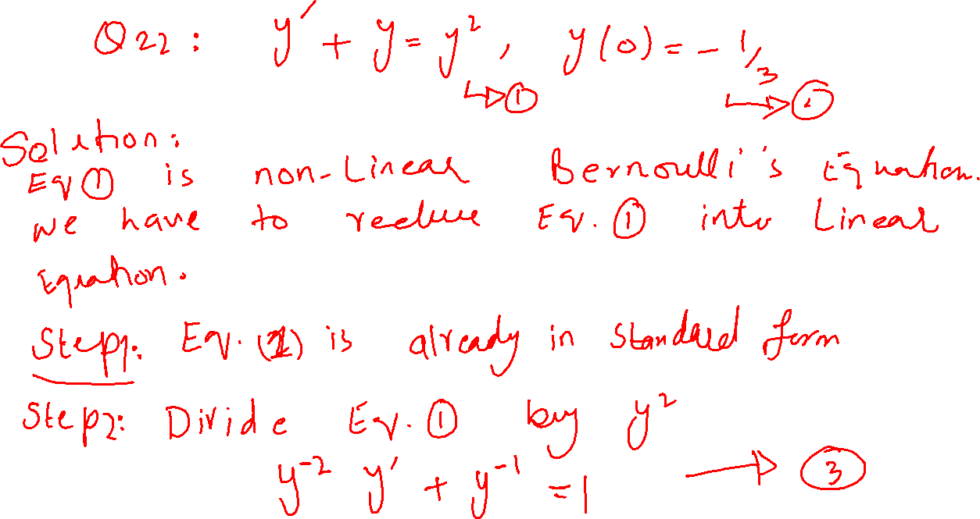

Slide 9


Slide 10


Slide 11


Slide 12


Slide 13


Slide 14


Slide 15




Slide 16


Slide 17


Slide 18


Slide 19


Slide 20


Slide 21


Slide 22


Slide 23
